Slide 1
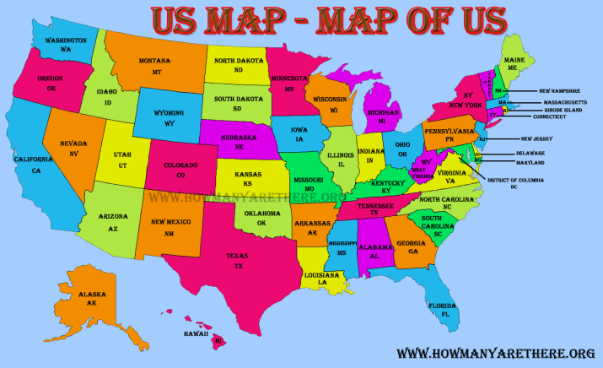
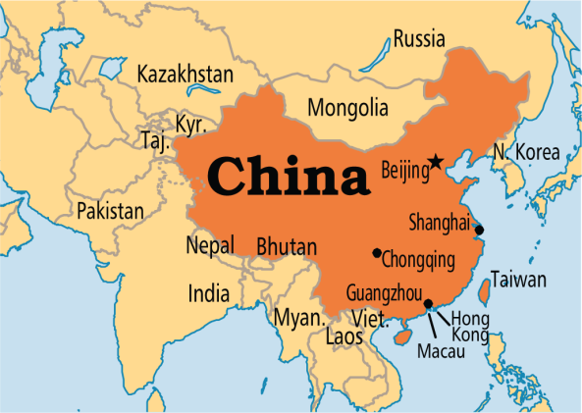
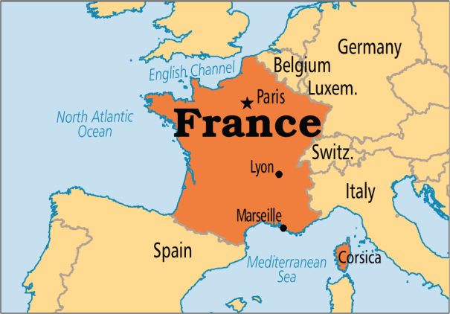
Internationalizing Number (I18N with Number)
The representation of the numbers differ from one locale to another. Internationalizing the numbers is good approach for the application that displays the information's according to the locales.
The NumberFormat class is used to format the number according to the specific locale.
Language = English
10,000.909
Language = Chinese
10,000.909
Language = French
10 000,909

Slide 2
Internationalizing Number (I18N with Number)
The NumberFormat class is used to format the number according to the specific locale.
To get the instance of the NumberFormat class, we need to call the below methods

